Slide 1
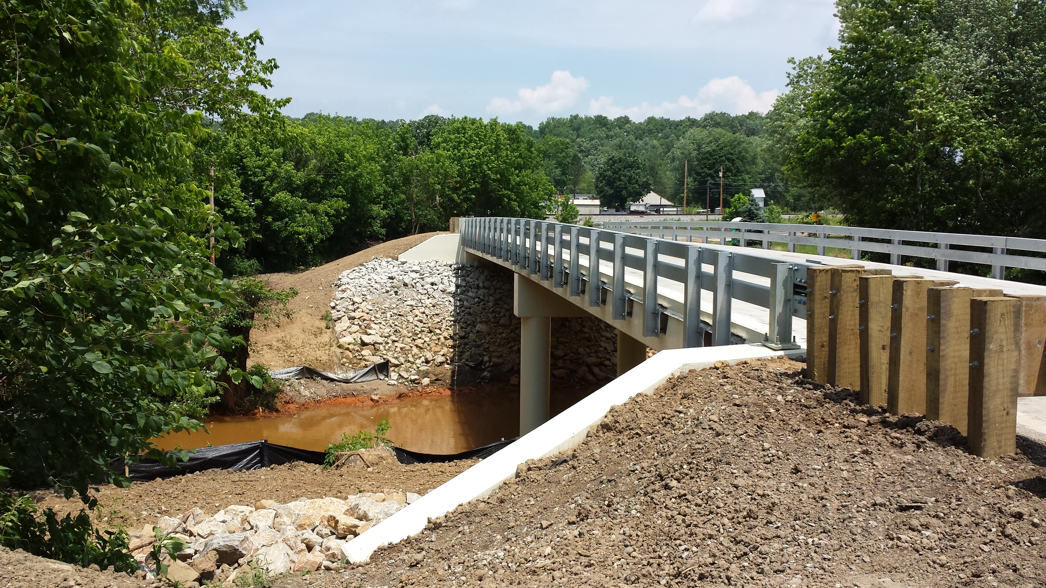
Conaway Conference March 15-16, 2016
“A Bridge from Concept to Construction”
A Contractor’s Perspective

Slide 2
Two perspectives: Larger and smaller contractor
Larger Contractor
Complete General Construction Company
Ashley Hoskins
Smaller Contractor
The Righter Company
Brad Nadolson

Slide 3
About us
Founded in 1928
Built Woody Hayes Drive bridge in 1930s and replaced in 2000s
Began overlays in 1970s
In the late 1990s, escalated to bridge rehabs and new builds
Recently average $50 million in bridge work per year
Bridge Division includes overlays, rehab of structures, new bridges, drilled shafts, retaining walls and noise walls

Slide 4
About us
Involved in bridge construction since 1976
Repaired, reconstructed or built 100+ bridges since 1986
Level 1, 2 & 3 Bridge Prequalified with ODOT
City of Columbus Prequalified
Past & Current Bridge Clients include:
ODOT
WVDOH
INDOT
Department of the Army
National Park Service
City of Columbus
Franklin County
Various other counties and municipalities

Slide 5
How DOES A CONTRACTOR FIND A PROJECT?
“Word of mouth” from owners or designers
Forecast nights or events
Plans from owners
Websites with lists of upcoming work
Bid Advertisements
Owner websites – ODOT, City of Columbus or others
Accurate descriptions of the work are important
Reporting services like Dodge Reports, BX Ohio or others

Slide 6
bid or no bid?
Expected number of bidders (owners want more, contractors less)
Project size – does it fit?
Previous experience on the type of project (bridge)
Estimating time and resources
Previous experience with the owner & designer
Project schedule and completion date
Workforce, supervisory and equipment availability
Constructability
Risks
Quality of plans
Company revenue targets & current workload

Slide 7
Let’s Bid! – things that affect price
How long do we have to put the estimate together?
Vague or conflicting plan notes – be clear – ambiguity helps contractor
Accuracy of quantities – minimize lump sum items
Quality of owner
Availability of existing plans & other investigative reports and information
Subsurface Investigations - adequacy
Constructability
Plan details
Easements and Right-of-Way
Waterway permits – get them before bidding
Utility Conflicts

Slide 8
Let’s Bid! – things that affect price
Schedule – Is it realistic?
Overtime premiums
Manpower availability and quality of life
Safety issues
Liquidated damages and disincentives
Inefficiency factors with large crews
Completion dates matter for weather sensitive work
Fabrication and other material lead times
Work Sequencing
Full closure vs. half-width

Slide 9
Let’s Bid! – preparing the estimate
Pre-bid meetings
Site visit or visits
Access – is it suitable for the work required?
Understanding the work – aided by good clear quality plans
Pre-bid questions
Answered
Answered clearly and effectively
Preliminary contractor prepared plans/designs – SWPP, demolition, shoring, falsework
Sometimes get outside help for these (consultants)

Slide 10
Let’s Bid! – preparing the estimate
Labor & Equipment
Crew-based estimating – each work items
Historical production rates – Units per LH or LH per unit
We don’t use a Means book or ODOT average prices!!!
Estimating software such as HCSS Heavy Bid

Slide 12
Let’s Bid! – preparing the estimate
Material take-offs and communicating with suppliers
Can we get accurate quantities with the provided info?
Clarity on specifications
Contacting and recruiting subcontractors to quote
DBE subcontracting goals realistic with the work 15%/7%

Slide 13
Low bid, now what?
Celebrate – Success rate in bidding can be between 1 in 5 to 1 in 10
Order long-lead items – sometimes even before the award!
Write purchase orders and subcontracts
Obtain special insurances – e.g. railroad protective
Develop the project schedule
Re-evaluate preliminary designs - finalize
Develop the needed shop drawings, contractor plans and submittals
Schedule and plan for the needed crews, equipment and other resources
Pre-construction meeting & internal pre-job meetings
Meeting with landowners, utilities, etc.

Slide 14
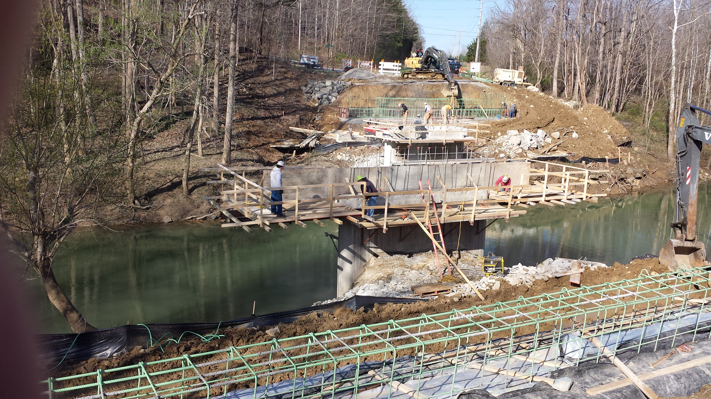
Building the bridge
Partnering (Let’s work together) relationships
Its not personal
Listen to the contractor
RFI’s - timely answers and information (both ways)
Can’t catch all the issues ahead of time – months versus weeks
Delays
Weather
Materials
Fabricated Items
Field verification issues

Slide 15
Improving the process
Clear answers to questions, especially in the pre-bid stage
Communicate frequently…and often
Never ever rely on designer’s “intent”
Contractor wants to build what you are “paying for” but not more
Mercedes S550 vs. Honda Civic LX
Adequate soils information – especially where sheeting/shoring/deep foundations or cofferdams are involved
Better plans mean more accurate, usually lower estimates/bids – less guesswork!
Better plans/specifications mean less conflicts and disputes

